Slide 1
FYP
Chapter: 10 – Formal Reports
Notes:
You will be writing a number of long, formal reports during your career. Most will be written collaboratively with colleagues; others will be just your creation.

Slide 2

Formal Reports
In comparison to informal documents, formal documents usually:
(1) cover more complicated projects
(2) are longer than their informal counterparts
(3) have a more diverse set of readers
Notes:
Readers who want just a quick overview can turn to the executive summary at the beginning or the conclusions and recommendations at the end; technical readers who want to check your facts and figures can turn to discussion sections or appendixes; and all readers can flip to the table of contents for a quick outline of what sections the document contains.

Slide 4
Headings in a Report
Second-level Heading in a Report
Third-level heading in a short report
Notes:
Use up to three levels of headings and indicate them clearly.

Slide 5
Decimal Headings

Slide 6
Parts of a Formal Reports and FYP

Slide 7
1. Cover/title page
2. Letter or memo of transmittal
3. Table of contents
4. List of illustrations
5. Executive summary
6. Introduction
7. Discussion sections
8. Conclusions and recommendations
9. End material
Notes:
The parts of formal documents are as follows

Slide 8
Formal Report | FYP
Cover/title page Letter or memo of transmittal Table of contents List of illustrations Executive summary Introduction Discussion sections Conclusions and recommendations End material | Title Page Undertaking Table of contents List of Tables List of Figures Abstract Introduction (Chapter-1) Literature Review (Chapter-2) Requirements and Design (Chapter: 3) Implementation and Test Scores (Chapter: 4) Results and Analysis (Chapter: -5) Conclusions (Chapter-6) References Appendix
Notes:
We can match the basic sections of the formal report with sections or chapters of FYP (Final Year Rport) that you will be working on

Slide 9
Cover/Title Page
■ Project title
■ Your client’s or recipient’s name (“Prepared for . . .”)
■ Your name and/or the name of your organization (“Prepared by . . .”)
■ Date of submission
Use a visual only if reinforces a main point.

Slide 10
Letter/memo of Transmittal
Place Letter/memo immediately after the title page
Include a major point from the report (Why you are writing/ What exactly of importance is within it
Follow letter and memo conventions (e.g. single-spacing; use only one page)

Slide 12
Table of Contents
It acts as an outline
It should be a complete and accurate listing of the main and minor topics covered in the report.
You don’t want just a brief and sketchy outline of major headings.
An effective table of contents fleshes out the details, so your readers know exactly what is covered in each section – saves their time and helps them find the information they want and need.

Slide 13
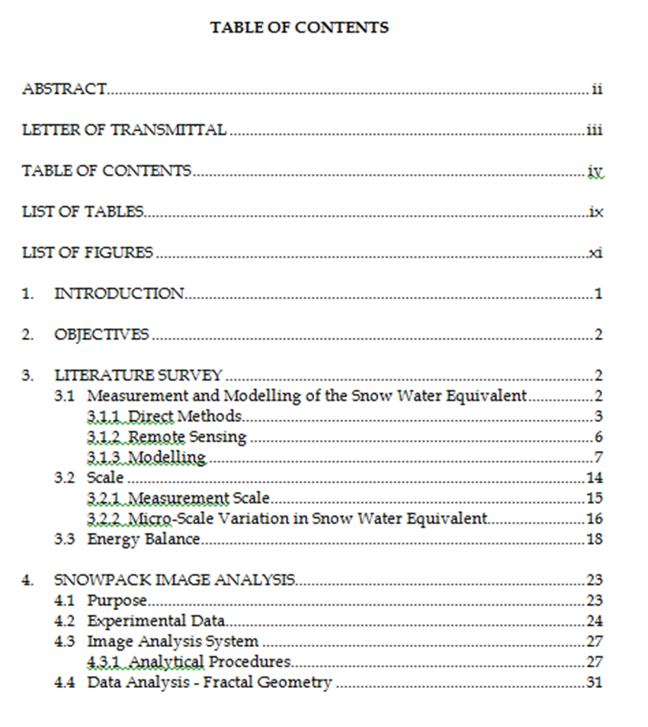

Slide 14
List of Illustrations
If your report contains several tables and figures, you will need to provide a list of illustrations.
This list can be included below your table of contents, if there is room on the page, or on a separate page.
As with the table of contents, your list of illustrations must be clear and informative.

Slide 15
Abstract (or Executive Summary)
The abstract is a brief overview of the report’s key points geared towards a varied audience from a low-tech reader to managers, supervisors, and highly placed executives.
They need your help in two ways:
They need information quickly
They need it presented in a low-tech terminology
You can achieve both these objectives through an abstract or executive summary.

Slide 16
Introduction
Not to summarize the report
Give information on, the report’s:
Purpose: State your purpose, as the first part of the introduction
Scope: detail and description of your project should be written clearly
Format: a brief preview of the main sections that follow

Slide 17
Conclusion/Recommendation
Providing your readers with a sense of closure
Discuss results based on findings of your study.
Recommendations are actions suggested on the basis of your conclusion.
Executive summary consists of a brief description of the most important conclusion and recommendation, whereas the conclusion/recommendation section is an expanded version of the executive summary.

Slide 18
Appendices
A final optional component is and appendix.
It allows you to include any additional information (surveys, results, tables, figures, previous report findings, relevant letters or memos, etc.) that you have not built in your report’s main text.
The contents of your appendix should not be of primary importance, which needs to be the part of the body of the report.
An appendix is a perfect place to file nonessential data that provides documentation for future reference.

Slide 19
References (or Bibliography)
The two parts to referencing are:
citations in the text of the report
a list of references in the final section
A citation shows that information comes from another source. The reference list gives the details of these sources. You need to use in-text citations and provide details in the references section when:
you incorporate information from other sources; e.g.:
factual material
graphs and tables of data
pictures and diagrams
Notes:
you quote word-for-word from another work (when you do this the page number must be given in the in-text citation)

Slide 20
In-text citation
Corrosion is defined as a 'chemical action which harms the properties of a metal' (Glendinning 1973, p.12). Because corrosion reduces the life of the material and protection procedures are expensive, special corrosion-resistant metals have been developed, including Monel metals which are particularly suited to marine applications (Glendinning 1973).
Reference list entry
Glendinning, E.H. 1973 English in mechanical engineering, Oxford, Oxford University Press.
Notes:
Example of in-text citation and reference list entry using the Harvard referencing style:

Slide 21
1.Writing an ABSTRACT
FORMAL REPORT WRITING

Slide 22
WHY?
You may write an abstract for various reasons.
The two most important are selection and indexing.
Selection:
After reading the abstract, one can make an informed judgment about whether the dissertation/article/report would be worthwhile to read.
Indexing:
Classifying information in order to make items easier to retrieve.

Slide 23
WHEN
Submitting articles to journals, especially online journals
Applying for research grants
Writing a book proposal
Completing the Ph.D. dissertation, M.A. thesis or project report.
Writing a proposal for a conference paper
Writing a proposal for a book chapter
Abstracts are written at the end of the project.

Slide 24
Qualities of a Good Abstract
Uses one well developed paragraph which is unified, coherent, concise, and able to stand alone.
Uses an introduction/body/conclusion structure which presents the article, paper, or report's purpose, method, Results, conclusion(s), and recommendations in that order.
Follows strictly the chronology of the article, paper, or report.
Provides logical connections (or transitions) between the information included.
Adds no new information, but simply summarizes the report.
Is understandable to a wide audience.
Any major restrictions or limitations on the results should be stated, if only by using "weasel-words" such as "might", "could", "may", and "seem".
Notes:
An effective abstract has the following qualities

Slide 25
Types of Abstracts
Descriptive: (less than 100 words)
Indicates the type of information found in the work.
Makes no judgments about the work, nor does it provide results or conclusions of the research.
Informative: (more than 250 words)
The writer presents and explains all the main arguments and the important results and evidence present in the complete report/article/paper/book.
Do not critique or evaluate a work, they do more than describe it.

Slide 26
Example (Descriptive): The two most common abstract types—descriptive and informative—are described and examples of each are provided.
Example (Informative): Abstracts present the essential elements of a longer work in a short and powerful statement. The purpose of an abstract is to provide prospective readers the opportunity to judge the relevance of the longer work to their projects. Abstracts also include the key terms found in the longer work and the purpose and methods of the research. Authors abstract various longer works, including book proposals, dissertations, and online journal articles. There are two main types of abstracts: descriptive and informative. A descriptive abstract briefly describes the longer work, while an informative abstract presents all the main arguments and important results. This handout provides examples of various types of abstracts and instructions on how to construct one.

Slide 27
Executive Summaries vs. Abstracts
Executive summaries go by so many different names. Sometimes the executive summary is called an Abstract. You usually find that designation in scientific papers and academic efforts. You can also call the Executive Summary simply a Summary.
Abstracts differ from executive summaries, because abstracts are usually written for a scientific or academic purpose.

Slide 28
Abstract Components (HOW)
Brief Backgound | (optional)
Reason for writing | What is the importance of the research? Why would a reader be interested in the larger work?
Problem | (Optional) What problem does this work attempt to solve? What is the scope of the project? What is the main argument/thesis/claim?
Methodology | An abstract of a scientific work may include specific models or approaches used in the larger study.
Reults/ Findings/ Implementation | An abstract of a scientific work may include specific data that indicates the results of the project.
Conclusion and Implications | What changes should be implemented as a result of the findings of the work?

Slide 29
Sample Abstract
This study’s objective was to/focuses on determine the strangeness measurements for red, green, and blue quarks. The Britt-Cushman method for quark analysis exploded/explode a quarkstream in a He gas cloud. Results indicate that both red and green quarks had a strangeness that differed by less than 0.453 x 10-17 Zabes/m2 for all measurements. Blue quarks remained immeasurable, since their particle traces bent into 7-tuple space. This study’s conclusions indicate that red and green quarks can be used interchangeably in all He stream applications, and further studies must be done to measure the strangeness of blue quarks.

Slide 30
Compound Sentence Segmentation and Sentence Boundary Detection in Urdu
The raw Urdu corpus comprises of irregular and large sentences which need to be properly segmented in order to make them useful in Natural Language Engineering (NLE). This makes the Compound Sentences Segmentation (CSS) timely and vital research topic. The existing online text processing tools are developed mostly for computationally developed languages such as English, Japanese and Spanish etc., where sentence segmentation is mostly done on the basis of delimiters. Our proposed approach uses special characters as sentence delimiters and computationally extracted sentence-endletters and sentence-end-words as identifiers for segmentation of large and compound sentences. The raw and unannotated input text is passed through preprocessing and word segmentation. Urdu word segmentation itself is a complex task including knotty problems such as space insertion and space deletion etc. Main and subordinate clauses are identified and marked for subsequent processing. The resultant text is further processed in order to identify, extract and then segment large as well as compound sentences into regular Urdu sentences. Urdu computational research is in its infancy. Our work is pioneering in Urdu CSS and results achieved by our proposed approach are promising. For experimentation, we used a general genre raw Urdu corpus containing 2616 sentences and 291503 words. We achieved 34% improvement in reduction of average sentence length from 111 w/s to 38 w/s (words per sentence). This increased the number of sentences by almost three times to 7536 shorter and computationally easy to manage sentences. Resultant text reliability and coherence are verified by Urdu language experts.
Notes:
Identify the components of abstract and if missing suggest possible.
Backgroud, Purpose, Problem, Method, Result

Slide 31
Compound Sentence Segmentation and Sentence Boundary Detection in Urdu
Background: The raw Urdu corpus comprises of irregular and large sentences which need to be properly segmented in order to make them useful in Natural Language Engineering (NLE). This makes the Compound Sentences Segmentation (CSS) timely and vital research topic.
Problem: The existing online text processing tools are developed mostly for computationally developed languages such as English, Japanese and Spanish etc., where sentence segmentation is mostly done on the basis of delimiters.
Purpose: Our proposed approach uses special characters as sentence delimiters and computationally extracted sentence-endletters and sentence-end-words as identifiers for segmentation of large and compound sentences.
Method: The raw and unannotated input text is passed through preprocessing and word segmentation. Urdu word segmentation itself is a complex task including knotty problems such as space insertion and space deletion etc. Main and subordinate clauses are identified and marked for subsequent processing. The resultant text is further processed in order to identify, extract and then segment large as well as compound sentences into regular Urdu sentences. Urdu computational research is in its infancy. Our work is pioneering in Urdu CSS and results achieved by our proposed approach are promising. For experimentation, we used a general genre raw Urdu corpus containing 2616 sentences and 291503 words.
Result: We achieved 34% improvement in reduction of average sentence length from 111 w/s to 38 w/s (words per sentence). This increased the number of sentences by almost three times to 7536 shorter and computationally easy to manage sentences. Resultant text reliability and coherence are verified by Urdu language experts.
Notes:
Identify the components of abstract and if missing suggest possible.

Slide 32
Urdu Language Translator using Deep Neural Network
It was clearly seen that the proposed model shows the high accuracy when the input is recorded audio and it shows poor performance with real time input. While one HTTP request per input transcription produced English translation for Text to Text translation using Python Text Blob library. This paper proposes an interactive Urdu to English language speech translator using deep Neural Network. ASR module in proposed pipeline is composed of deep neural network and is simpler as compared to traditional ASR which requires complex hand engineering like feature extraction and resources like phoneme dictionary. The proposed speech recognition model out performs traditional automatic speech recognition systems in efficiency, simplicity and robustness. The final output was achieved with a delay of no more than 30 seconds. Furthermore, we have tested and provided some statistical findings, the result shows that value updating for neural network layer’s bias, standard deviation when Adam optimizer parameters are set as follows: beta1=0.9, beta2=0.9 and learning rate =0.01 meanwhile dropout rate was kept to 5% to offer regularization and observed value for scalar maximum lies between 0 and 0.08. There is a little deviation at 0.05 step, value decreases and afterwards that bias maximum scalar increases with positive values and finally increases exponentially at later stages of training further results are discussed in experiment section respectively.
Notes:
Arrange the abstract: Purpose, Method, Result, Conclusion

Slide 33
Urdu Language Translator using Deep Neural Network
Purpose: This paper proposes an interactive Urdu to English language speech translator using deep Neural Network. ASR module in proposed pipeline is composed of deep neural network and is simpler as compared to traditional ASR which requires complex hand engineering like feature extraction and resources like phoneme dictionary.
Method: It was clearly seen that the proposed model shows the high accuracy when the input is recorded audio and it shows poor performance with real time input. While one HTTP request per input transcription produced English translation for Text to Text translation using Python Text Blob library.
Result: The final output was achieved with a delay of no more than 30 seconds. Furthermore, we have tested and provided some statistical findings, the result shows that value updating for neural network layer’s bias, standard deviation when Adam optimizer parameters are set as follows: beta1=0.9, beta2=0.9 and learning rate =0.01 meanwhile dropout rate was kept to 5% to offer regularization and observed value for scalar maximum lies between 0 and 0.08. There is a little deviation at 0.05 step, value decreases and afterwards that bias maximum scalar increases with positive values and finally increases exponentially at later stages of training further results are discussed in experiment section respectively.
Conclusion: The proposed speech recognition model out performs traditional automatic speech recognition systems in efficiency, simplicity and robustness.
Notes:
Answer

Slide 34
Toward Revision-Sensitive Feedback in Automated Writing Evaluation
Introduction
Automated writing evaluation (AWE) systems provide computer-based scores and feedback on students’ writing, and can promote modest gains in writing quality [1, 2]. One concern is that students receive feedback on their current drafts that ignores patterns of change from draft to draft. We argue AWE tools should include feedback models that incorporate data on students’ revising behaviors and textual changes. These innovations may afford greater personalization of formative feedback that helps students recognize how their editing actions affect writing quality.
This study used Writing Pal (W-Pal), a tutoring and AWE system that supports writing instruction and practice [3, 4]. When submitting essays to W-Pal, students receive scores (6-point scale) and feedback with actionable suggestions for improvement. Scoring and feedback are driven by natural language processing (NLP) algorithms that evaluate lexical, syntactic, semantic, and rhetorical text features [1, 5]. One goal for W-Pal development is feedback that promotes more effective revising [see 4].
Notes:
Read the article and write an abstract

Slide 35
Method
2.1 Context and Corpus
High school students (n = 85) used W-Pal to write persuasive essays on the topic of “fame.” Most identified as native English speakers (56%) and others as English-language learners (44%).
2.2 Detection and Annotation of Revising
We calculated difference scores between drafts for several NLP measures (via Coh-Metrix [5, 6]). Lexical measures assessed word choice and vocabulary, such as word frequency and hypernymy. Cohesion indices assessed factors such as overall essay cohesion, semantic relatedness (using LSA), and structure.
Human annotation of revisions adapted methods from prior research [7, 8]. Writers can alter their text via adding, deleting, substituting, or reorganizing actions. Human coding of these revision actions showed high reliability (κ = .92). Revisions can also maintain (superficial edits) or transform (substantive edits) the meaning of surrounding text. Human coding of revision impact on text meaning also demonstrated high reliability (κ = .81).

Slide 36
Results
3.1 Automated Detection of Revising
Essays demonstrated detectable changes in linguistic features from original to revised drafts. Revised essays were longer, included more transitional phrases and first-person pronouns, and were somewhat more cohesive (see Table 1).
 |  | Linguistic |  | Correlation with
 |  | Change |  | Score Change
 | Linguistic Change | t(84) | p | r(84) | p
 | Basic
 | Word Count | 6.24 | < .001 | .06 | .593
 | Sentence Count | 4.33 | < .001 | -.09 | .393
 | Lexical
 | Lexical Diversity | -0.28 | .781 | .17 | .124
 | Word Concreteness | 0.83 | .410 | .34 | .002
 | Word Familiarity | -0.74 | .463 | -.01 | .954
 | Word Hypernymy | 0.80 | .424 | .24 | .028
 | 1st Person | 2.09 | .040 | -.07 | .545
 | 2nd Person | -1.06 | .294 | -.22 | .043
 | 3rd Person | -0.23 | .818 | -.10 | .342
 | Cohesion
 | Connectives | 1.67 | .099 | .03 | .809
 | LSA Given/New | 2.98 | .004 | .08 | .484
 | LSA Sentences | 0.58 | .562 | .24 | .029
 | LSA Paragraphs | 1.86 | .066 | -.08 | .465
 | Deep Cohesion | 0.71 | .478 | .18 | .098
 | Referential Cohesion | 0.52 | .607 | .01 | .893
 | Narrativity | 1.05 | .296 | -.25 | .023

Slide 37
Results
Essay quality increased from original (M = 2.7, SD = 1.0) to revised drafts (M = 2.9, SD = 1.1), t(84) = 3.64, p < .001, d = .19. Gains correlated with increased concreteness, specificity, objectivity (i.e., fewer 2nd-person pronouns and less story-like), and cohesion. Importantly, the linguistic changes linked to gains were not the most typical changes. This finding reinforces the idea that students are not skilled revisers—their revising behaviors can be dissociated from actions that improve the quality of their work.
3.2 Human Annotation of Revising
The most common revisions were additions (47.5%) and substitutions (33.6%). Deletions (15.4%) and reorganizations (2.5%) occurred less often. None of the revising actions were correlated with changes in essay score. This finding reiterates the point that high school students are not necessarily skilled revisers.
3.3 Relationships between Modes of Analysis
The total number of revisions was not related to linguistic changes across drafts (range of rs from -.18 to .12). Simply revising more had minimal effects. Additions, substitutions, and reorganization had few effects. In contrast, deletions were associated with reductions in narrativity and third-person pronouns. Along with reduced word familiarity, this pattern suggests that students were removing story-like language. Deletions were also associated with reduced given information, semantic similarity across paragraphs, and referential cohesion. Thus, as students removed content from their essays, the cohesive flow of ideas was perhaps hindered. Overall, deletions seemed to be linked to both gains and setbacks in essay quality (see Table 2).

Slide 38
Results
Linguistic Change | Add | Delete | Subst. | Reorg.
Basic
Word Count | .29^{b} | -.36ª | -.18 | -.10
Sentence Count | .37ª | -.18 | -.16 | .05
Lexical
Lexical Diversity | .01 | .26^{c} | -.04 | .07
Word Concreteness | .00 | .29^{b} | .08 | .06
Word Familiarity | -.04 | -.28^{c} | .15 | -.09
Word Hypernmy | -.10 | .11 | .02 | -.18
1st Person | .04 | -.11 | .11 | .07
2nd Person | -.09 | -.03 | -.05 | -.04
3rd Person | -.01 | -.26^{c} | -.07 | .00
Cohesion
Connectives | -.07 | .16 | .09 | -.03
LSA Given/New | -.02 | -.32^{c} | -.07 | -.07
LSA Sentences | -.20 | -.09 | .06 | -.12
LSA Paragraphs | .07 | -.24^{c} | -.05 | .04
Deep Cohesion | .00 | -.11 | .07 | -.07
Referential Cohesion | -.10 | -.25^{c} | .12 | -.03
Narrativity | -.07 | -.34ª | -.01 | .01
Note. ªp ≤ .001. ^{b}p ≤ .01. ^{c}p ≤ .05.

Slide 39
A final analysis examined revisions by both type and impact. As in the previous analysis, the most meaningful linguistic changes were associated with deletions, with substantive deletions appearing to have the strongest influence. Superficial deletions tended to make essays more personalized (i.e., more 1st-person pronouns) and less specific. Substantive deletions tended to make essays shorter, less story-like, more sophisticated in terms of vocabulary, and less cohesive.
Discussion
Our results provide evidence that automated tools can detect linguistic changes in students’ writing. Formative feedback based on such measures might help students appreciate when and how their drafts evolve over time. For instance, when an increase in narrativity or decrease in cohesion are detected, feedback could flag the edited sections of text so that conscientious students can draw inferences about the impact of their revisions.
Ideally, AWEs should also be able to detect and give feedback on revising behaviors. From the current study, however, it is unclear whether linguistic data could be used to identify such behaviors. With the exception of deletions, students’ revising actions did not have a profound impact on linguistic properties.
One solution may reside in keystroke logging [9]. Keyboard and mouse clicks made while interacting with an AWE system may be interpretable with respect to revising. For example, backspace presses may indicate deletion. The use of mouse buttons to select text, along with “CTRL-X” and “CTRL-V” hotkey functions, could signal reorganization. If such tools can be added to AWEs, they may provide real-time measures of writing and revising behaviors that can be explicitly linked to linguistic consequences.

Slide 40
THANKS!
Any questions?
You can find me at:
Hajra.ikram@nu.edu.pk

